Slide 1




NEXT GEN EMPLOYABILITY PROGRAM
Creating a Future-Ready Workforce
Loyola-ICAM College Of Engineering And Technology
Team Members
Student Name : ALLAN THIYAGASEELAN
Student ID : au311121205007
Chennai

Slide 2

CAPSTONE PROJECT SHOWCASE
Project Title
Music Web Application using Django Framework
Abstract | Problem Statement | Project Overview | Proposed Solution | Technology Used | Modelling & Results | Conclusion

Slide 3
Abstract
.
MusicApp is a Django-based web application designed to manage and share music tracks online. The project aims to provide a user-friendly platform for uploading, browsing, and listening to music, complete with metadata such as artist, album, and genre information. Users can easily upload their favorite songs and album cover images, which are then displayed in an organized manner on the website.
The application leverages Django's powerful features to handle user authentication, database management, and file storage. It utilizes a modern and responsive design with Bootstrap for a sleek user interface. By combining Django's backend capabilities with HTML, CSS, and JavaScript for the frontend, MusicApp offers a seamless and enjoyable music-sharing experience
Source :

Slide 4
Problem Statement
With the rise of digital music consumption, there is a need for a centralized platform where users can upload and share their music collections. Existing music streaming services may be restrictive or require subscriptions. This project addresses the need for a simple, free-to-use platform that allows users to upload, browse, and listen to music without any complex restrictions.n the modern era of digital music consumption, existing music streaming platforms often impose limitations such as subscription fees and regional restrictions, hindering the seamless enjoyment and sharing of music. Many users seek a user-friendly, free-to-use platform where they can upload, organize, and share their music collections without unnecessary complexities.
MusicApp aims to address these challenges by providing a centralized and accessible platform for users to manage and share their music effortlessly. By offering a straightforward interface and eliminating subscription requirements, MusicApp empowers music enthusiasts to enjoy their favorite tracks without barriers.
Source :

Slide 5
Project Overview
The MusicApp project is a Django-based web application designed to facilitate the management and sharing of music online. It offers essential features for uploading, browsing, and listening to music tracks seamlessly.
Song Upload
MusicApp allows users to upload their favorite music tracks along with metadata such as title, artist, album, and genre. Additionally, users can optionally upload cover images associated with each song to enhance the visual presentation.
Song List
The application displays a visually appealing list of uploaded songs, showcasing cover images, song titles, and artist names. Users can easily browse through the song list and select songs of interest.
Song Details
Upon selecting a song from the list, detailed information about the song is presented. This includes the album cover image, artist name, album title, and genre. An HTML5 audio player is embedded to enable users to listen to the song directly from the platform.
Source :

Slide 6
Proposed Solution
To address the problem statement, we developed MusicApp using the Django framework along with HTML, CSS, and Bootstrap for front-end design. The application utilizes a SQLite database to store user data, song metadata, and uploaded media files (song audio and cover images). Django's built-in user authentication system is leveraged for user management.
Key components of the solution include:
User Authentication: Django's authentication system ensures secure user registration and login.
Song Upload Form: Custom Django forms allow users to upload songs along with associated metadata.
Song Listing and Detail View: Django views render song lists and detailed song information using templates.
Media Storage: Uploaded media files are stored in the media/ directory and served through Django's static file serving capabilities.
.
Source :

Slide 7
SOLUTION:
The proposed solution also includes a robust backend infrastructure for seamless music streaming within the application. This eliminates the need for external plugins or software. Leveraging Django's powerful ORM and caching mechanisms, the application ensures efficient data retrieval and delivery, enhancing overall performance and user experience. Additionally, the integration of cloud storage solutions for music files enables scalable and reliable content delivery, accommodating a growing user base and expanding music library.
Source :

Slide 8
SOLUTION:
Moreover, the project will prioritize user feedback and iterative development to continuously enhance and refine the application's features and functionalities. Through user testing and analytics, the team will gather insights to optimize the user experience, improve recommendation accuracy, and address any usability issues. Additionally, regular updates and maintenance will ensure the application remains secure, up-to-date with industry standards, and capable of meeting evolving user needs. By adopting an agile development approach and incorporating user-centric design principles, the proposed solution aims to deliver a cutting-edge music web application that sets new standards for personalized music discovery and engagement.

Slide 9


Technology Used
Front-end
Back-end
Source :

Slide 10
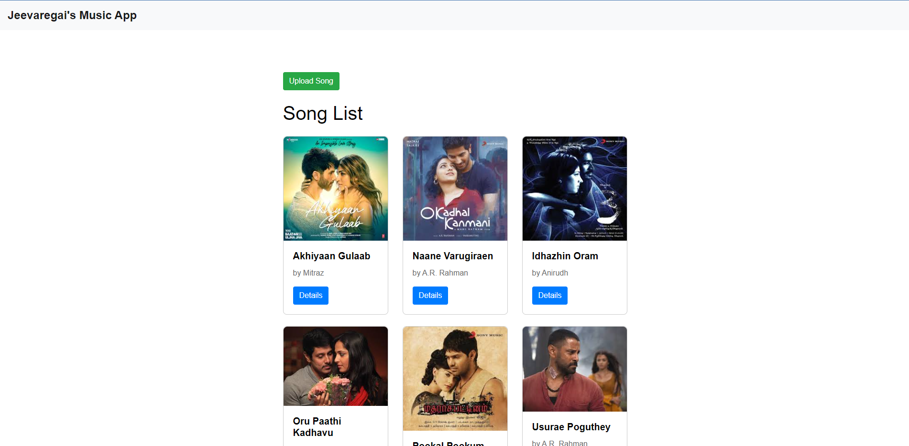

Slide 11
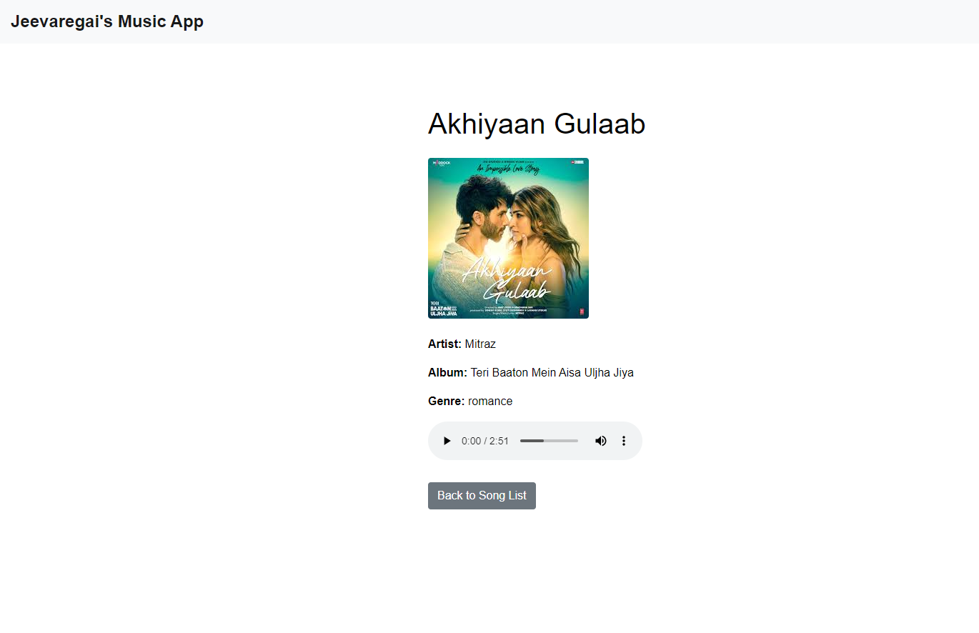
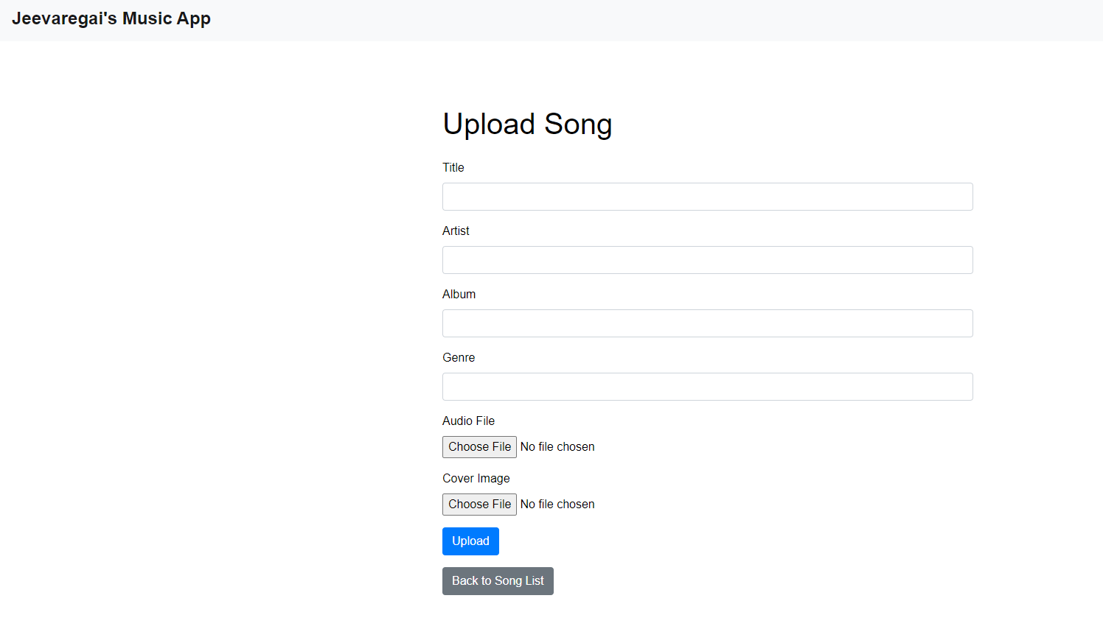

Slide 12
Modelling & Results
Data Modelling:
The project begins with data modelling, defining the database schema using Django's ORM (Object-Relational Mapping).
Entities such as User, Playlist, Song, and Artist are modelled, with appropriate relationships established to represent user interactions and music content organization.
Customizations such as defining primary keys and optimizing database queries are implemented to ensure efficient data storage and retrieval.
Implementation and Results:
Following data modelling, the implementation phase focuses on building features to enable music discovery, organization, and social interaction.
User registration and authentication functionalities are developed to provide personalized experiences and secure access to the application.
A comprehensive music library is implemented, allowing users to browse, search, and explore a vast collection of songs, albums, and artists.
Personalized playlist creation features enable users to curate their own collections of favorite songs, while recommendation systems suggest relevant music based on user preferences and listening history.
Source :

Slide 13
Future Enhancements:
Personalized Recommendations: Utilize advanced algorithms to analyze user listening habits, preferences, and contextual data to offer tailored music recommendations.
Social Integration: Implement features that enable users to connect with friends, share playlists, view what others are listening to, and collaborate on music discovery.
AI-Driven Playlist Creation: Employ artificial intelligence algorithms to curate playlists based on user preferences, mood, activity, and even contextual factors like weather or location.
Enhanced Discovery Tools: Develop tools such as interactive maps showcasing local music scenes, virtual concerts, or immersive experiences for users to explore new genres and artists.
Lyric Integration: Integrate lyrics into the app, allowing users to follow along with songs, search based on specific lyrics, and even provide translations for multilingual lyrics.
Live Streaming and Virtual Concerts: Partner with artists and venues to offer live streaming of concerts, virtual reality experiences, and exclusive behind-the-scenes content for users.
Music Education Resources: Provide tutorials, instrument lessons, music theory quizzes, and interactive challenges to help users learn more about music and improve their skills.
Voice Control and Integration: Enable voice-controlled commands for hands-free operation, allowing users to search for songs, control playback, and navigate the app using voice commands.

Slide 14
Conclusion
MusicApp provides a straightforward solution for sharing and managing music collections online. Leveraging Django's capabilities, the project facilitates seamless music uploading and browsing.
Moving forward, potential enhancements like advanced search functionalities, user profiles, and playlist management could enrich the user experience, making MusicApp more personalized and interactive.
The project's focus on simplicity, efficiency, and accessibility underscores its commitment to providing a user-friendly platform for music enthusiasts. By embracing user feedback and continuous improvement, MusicApp aims to evolve into a comprehensive and engaging music sharing ecosystem.
In summary, MusicApp serves as a foundational platform for music enthusiasts to share, explore, and enjoy music collections online, with ongoing potential for enhancements to meet evolving user needs.
Source :

Slide 15
Thank You!
Notes:
Thank You !!

